Slide 1



1st Ham License Class &
1st Rig Build Workshop
A proposal for the
Motor City Radio Club

Slide 2
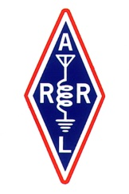

Partnership
Amateur Radio Core values
IEEE Core values
Culture of Elemers
service to the public
Enhance international goodwill
advancement of the radio art
advancing skills in both the communication and technical
trained operators, technicians, and electronics experts
Growth and nurturing
Service to humanity
Global community building
Trusted technical Information
encouraging education as a fundamental activity of engineers, scientists, and technologists

Slide 3
STEM & Amateur Radio
STEM (Science, Technology, Engineering, Math)
STEM classes at many levels are part of the IEEE and stress a ‘Hands On’ approach to learning.
Amateur Radio has always been a ‘Hands On’ activity and a training ground on many levels.

Slide 4
STEM & Amateur Radio
Amateur Radio can give IEEE STEM classes a clear objective for students:
Part of an organization of interesting people
Linked to public & emergency services
Experimental technical opportunities
Unique training and experiences
Global communications capability
Membership in a supportive community

Slide 5
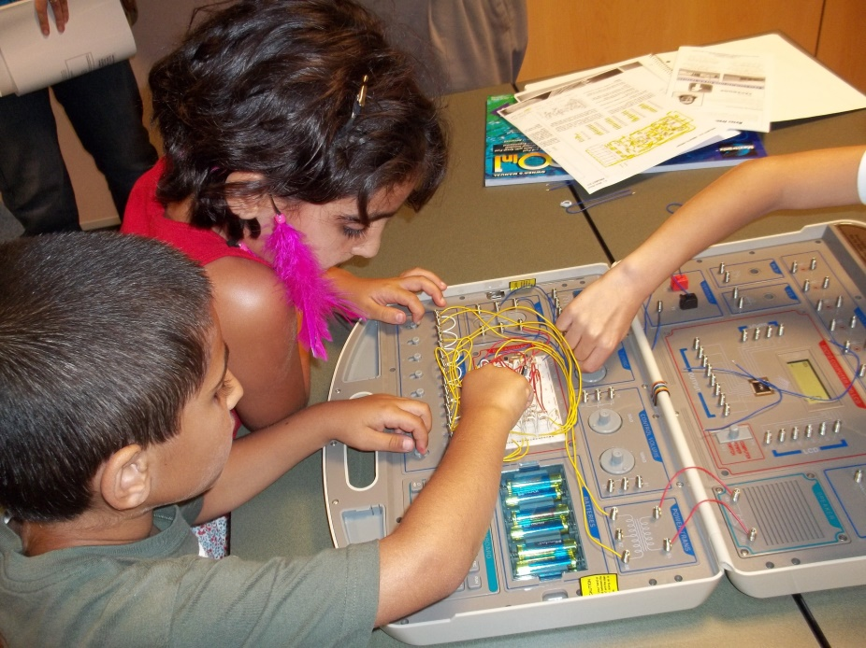
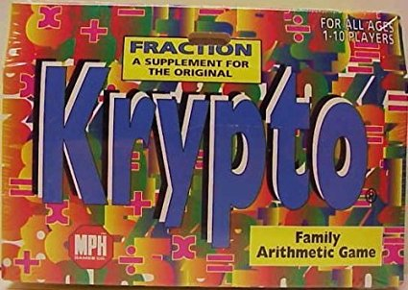
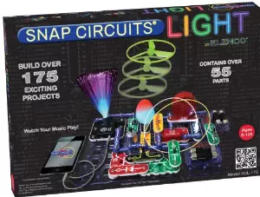
STEM Class Cycle
STEM in Southeastern Michigan has evolved these components:
Krypto: Math card game (in schools)
Library (donated) science learning kits

Slide 6
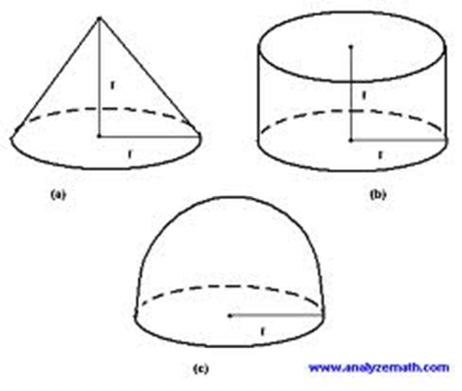
STEM Class Cycle
STEM in Southeastern Michigan has evolved these components:
Krypto: Math card game (in schools)
Library (donated) science learning kits
Observation & Measurement Class
Fundamentals of Electricity Class
Nothing to follow…..

Slide 7
Amateur Radio Class(es)
Proposing we follow the IEEE ‘Fundamentals of Electricity’ class with ‘Amateur Radio’….
10 Week Technician License Class:
KB6NU Dan Romanchick’s
  “No-Nonsense Technician Class License Study Guide”
Plus - Morse Code Class (Koch method)
11th Week: VE Exam (Optional)
Then…..

Slide 8
‘Makers’ Classes
Teach safe & correct soldering methods,
Build a series of progressively more challenging kit projects,
The series of kits to assemble a complete QRP CW radio station,
Staged ‘prof of operation’ by Licensed Hams,
Concluding with 1st contact assistance.

Slide 9
Soldering Basics
Home work: Read Before Class.
          SOLDERING TIPS
          by: Tom Hammond, NØSS
          Available ‘on-line’.
“Close” instruction on 1st circuit,
Build their first simple kit with close supervision,
Test operation at conclusion of class (with corrections of any errors).

Slide 10
Circuit 1
12 Watt Dummy Load
RF Power Measurement
  Resistors
  Capacitors
  Diodes
  Header strip
  BNC Connector

Slide 12
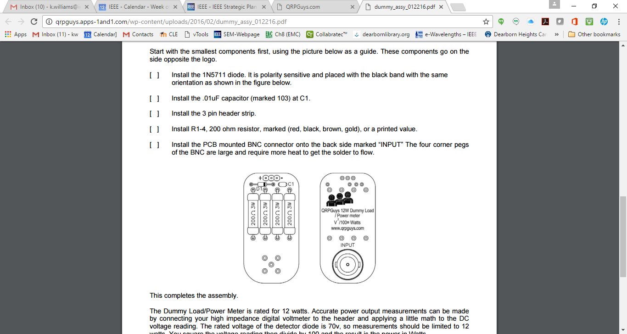

Slide 13
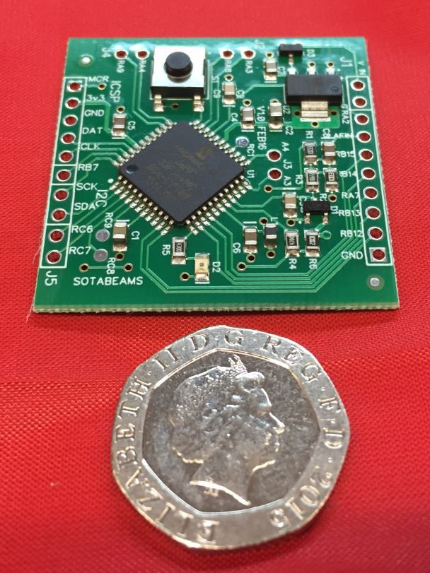
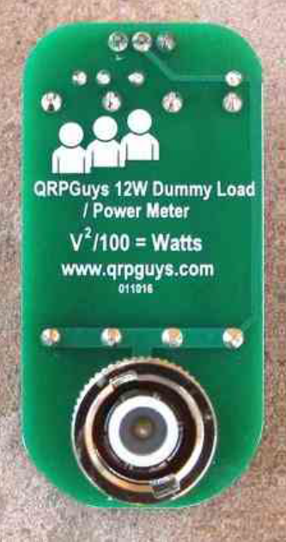
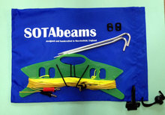
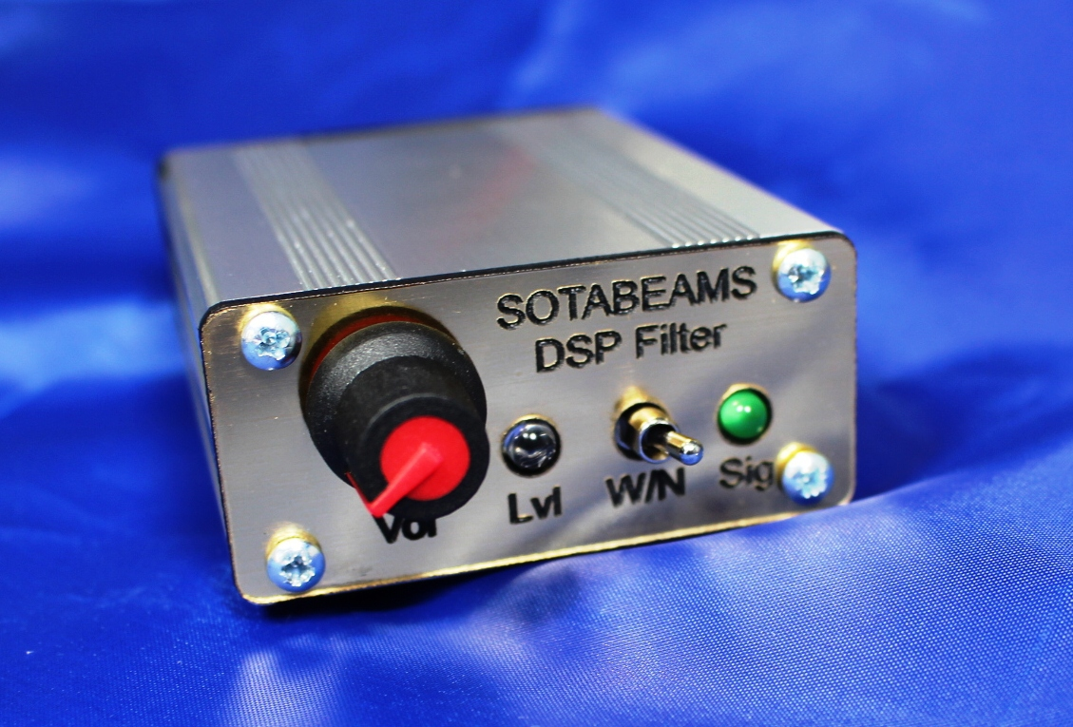
Suggested Construction Sequence
Kits
Difficulty Rating
12 Watt Load & Pwr Mtr,
Antenna Tuner (2 options)
Single Lever Paddle / Keyer
Digital Frequency Counter
Forty-9er QRP Rig
CW Audio Filter
Half Wave Dipole
Battery & Charger –
1
2/3
3
3
5
4
Easy
Easy

Slide 14
Suggested Construction Sequence
(Students pay for their own ‘kits’)
Kits
Cost $
12 Watt Load & Pwr Mtr,
Antenna Tuner (2 options)
Single Lever Keyer /Paddle
Digital Frequency Counter
Forty-9er QRP Rig
CW Audio Filter
Long Wire / Dipole
Battery & Charger Sys.
$10
$25 / $35
$25
$15
$18
$36
$29 / $60
TBD

Slide 15
Suggested Class Sequence
License & CW Classes
QRP Kit Builders Workshops
What is Amateur Radio?
Electrical principles
Electronic principles & components
Radio and electromagnetic waves
Antennas and Feedlines
Amateur Radio Signals
Be Safe!
Station Setup and Operation
Operating Procedures
Rules and Regulations
Optional Exam ($15.00 FCC Fee)
Orientation & Registration
12 Watt Load & Pwr. Mtr.,
Antenna Tuner (2 options)
Single Lever Keyer /Paddle
Digital Frequency Counter
Forty-9er QRP Rig
CW Audio Filter
Long Wire / Dipole
Battery & Charger Sys.
Getting on the Air!

Slide 16
Next Steps
Commitment from MCRC Elmers
  License Class &
  Morse Code portion
  Parallel, or following QRP Kit Builders Workshops
Lock in Dates with Library, or alternative(?)
  License & Code Classes
  Kit Builders Workshops
Seek funding for Soldering Equipment

Slide 17
Elmers Sign Up Sheet
Tentative Schedule start: April 10
Asking now for member ‘interest’ only.
No firm commitment at this time
If our Elmers show sufficient interest, we will proceed with arrangements.

Slide 18
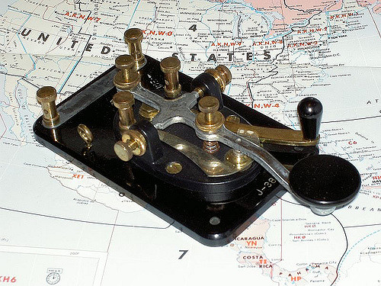
Questions / Comments

